Slide 1
Big Mountain Ski Resort Ticket Pricing
Sidney McDermott
Springboard guided capstone project

Slide 2
Big Mountain Resort’s Business Problem
An additional chair lift has been installed which increases operating costs by $1,540,000 this season. Given data on competitor ski resorts, can Big Mountain Resort raise ticket prices to cover the cost of the new lift?
The business has also asked how the four following scenarios effect ticket pricing:
Permanently closing down up to 10 of the least used runs. This doesn't impact any other resort statistics.
Increase the vertical drop by adding a run to a point 150 feet lower down but requiring the installation of an additional chair lift to bring skiers back up, without additional snow making coverage
Same as number 2, but adding 2 acres of snow making cover
Increase the longest run by 0.2 mile to boast 3.5 miles length, requiring an additional snow making coverage of 4 acres

Slide 3
Recommendation and key findings
Big Mountain Resort’s features support adult weekend ticket prices between $85.48 and $95.87
Closing 1-10 runs changes ticket prices on a scale
1 run makes no difference to ticket pricing
2 reduces support for ticket price by $0.40
3-5 runs reduces support for ticket price by $0.66
6+ leads to a large drop in ticket pricing (> $1.25) and revenue
Increasing vertical drop, without making snow, increases support for ticket price by $1.99. Over the season, this could be expected to amount to $3,474,638 in revenue.
Increasing vertical drop, while making snow, does not provide further revenue over the scenario without making snow.
Increasing the length of the longest run does not impact ticket pricing.

Slide 4
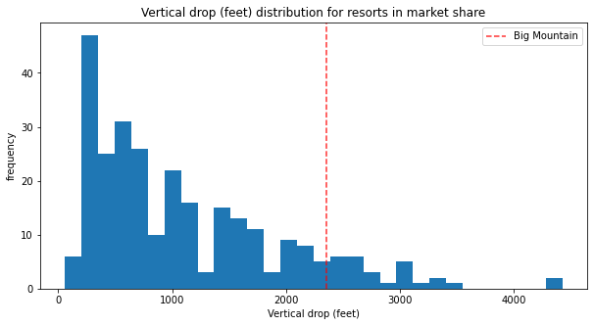
Modeling results and analysis
The following graphs show where Big Mountain Resort falls in the market compared to their competitors. All features graphed are showed to be important to the market, and therefore, pricing.
Notes:
Big Mountain is doing well for vertical drop, but there are still quite a few resorts with a greater drop.

Slide 5
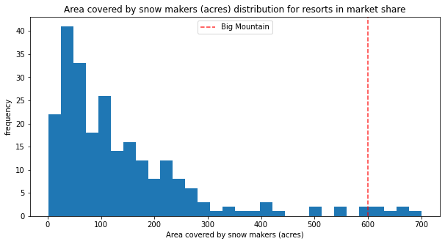
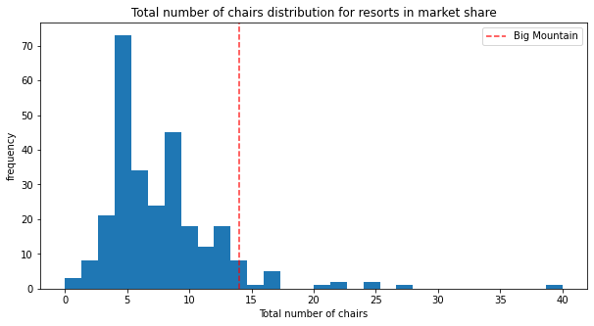
Modeling results and analysis (cont.)
Notes:
Big Mountain is very high up the league table of snow making area.
Big Mountain has amongst the highest number of total chairs, resorts with more appear to be outliers.

Slide 6
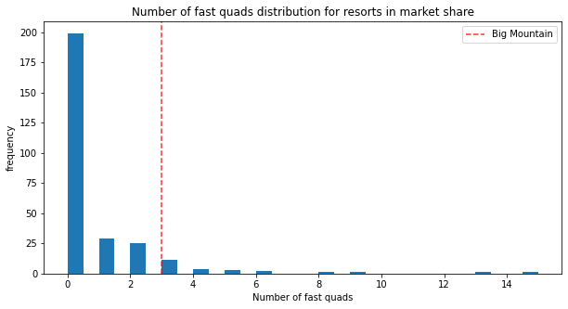
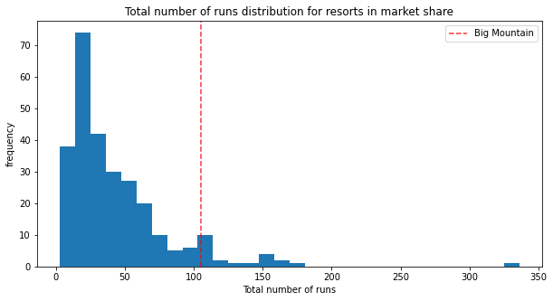
Modeling results and analysis (cont.)
Notes:
Most resorts have no fast quads. Big Mountain has 3, which puts it high up that league table. There are some values much higher, but they are rare.
Big Mountain compares well for the number of runs. There are some resorts with more, but not many.

Slide 7
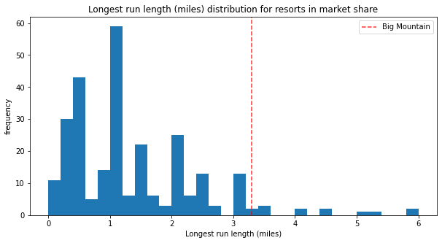
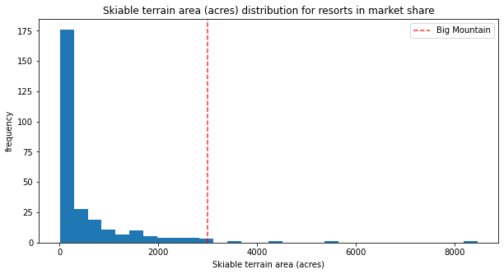
Modeling results and analysis (cont.)
Notes:
Big Mountain has one of the longest runs. Although it is just over half the length of the longest, the longer ones are rare.
Big Mountain is amongst the resorts with the largest amount of skiable terrain.

Slide 8
Summary and Conclusion
Big Mountain Resort has many features that appeal to the ticket-buying public. Currently the resort is undercharging for tickets and the market will support raising prices to between $85.48 and $95.87 for an adult weekend ticket.
To further increase ticket value, and therefore revenue, the resort could consider increasing the vertical drop.
Decreasing the number of runs could also be considered but without operating cost data, no recommendation can be made at this time.
Just by raising ticket prices, Big Mountain Resort will more than cover the additional operating costs of the new lift.

